Slide 1
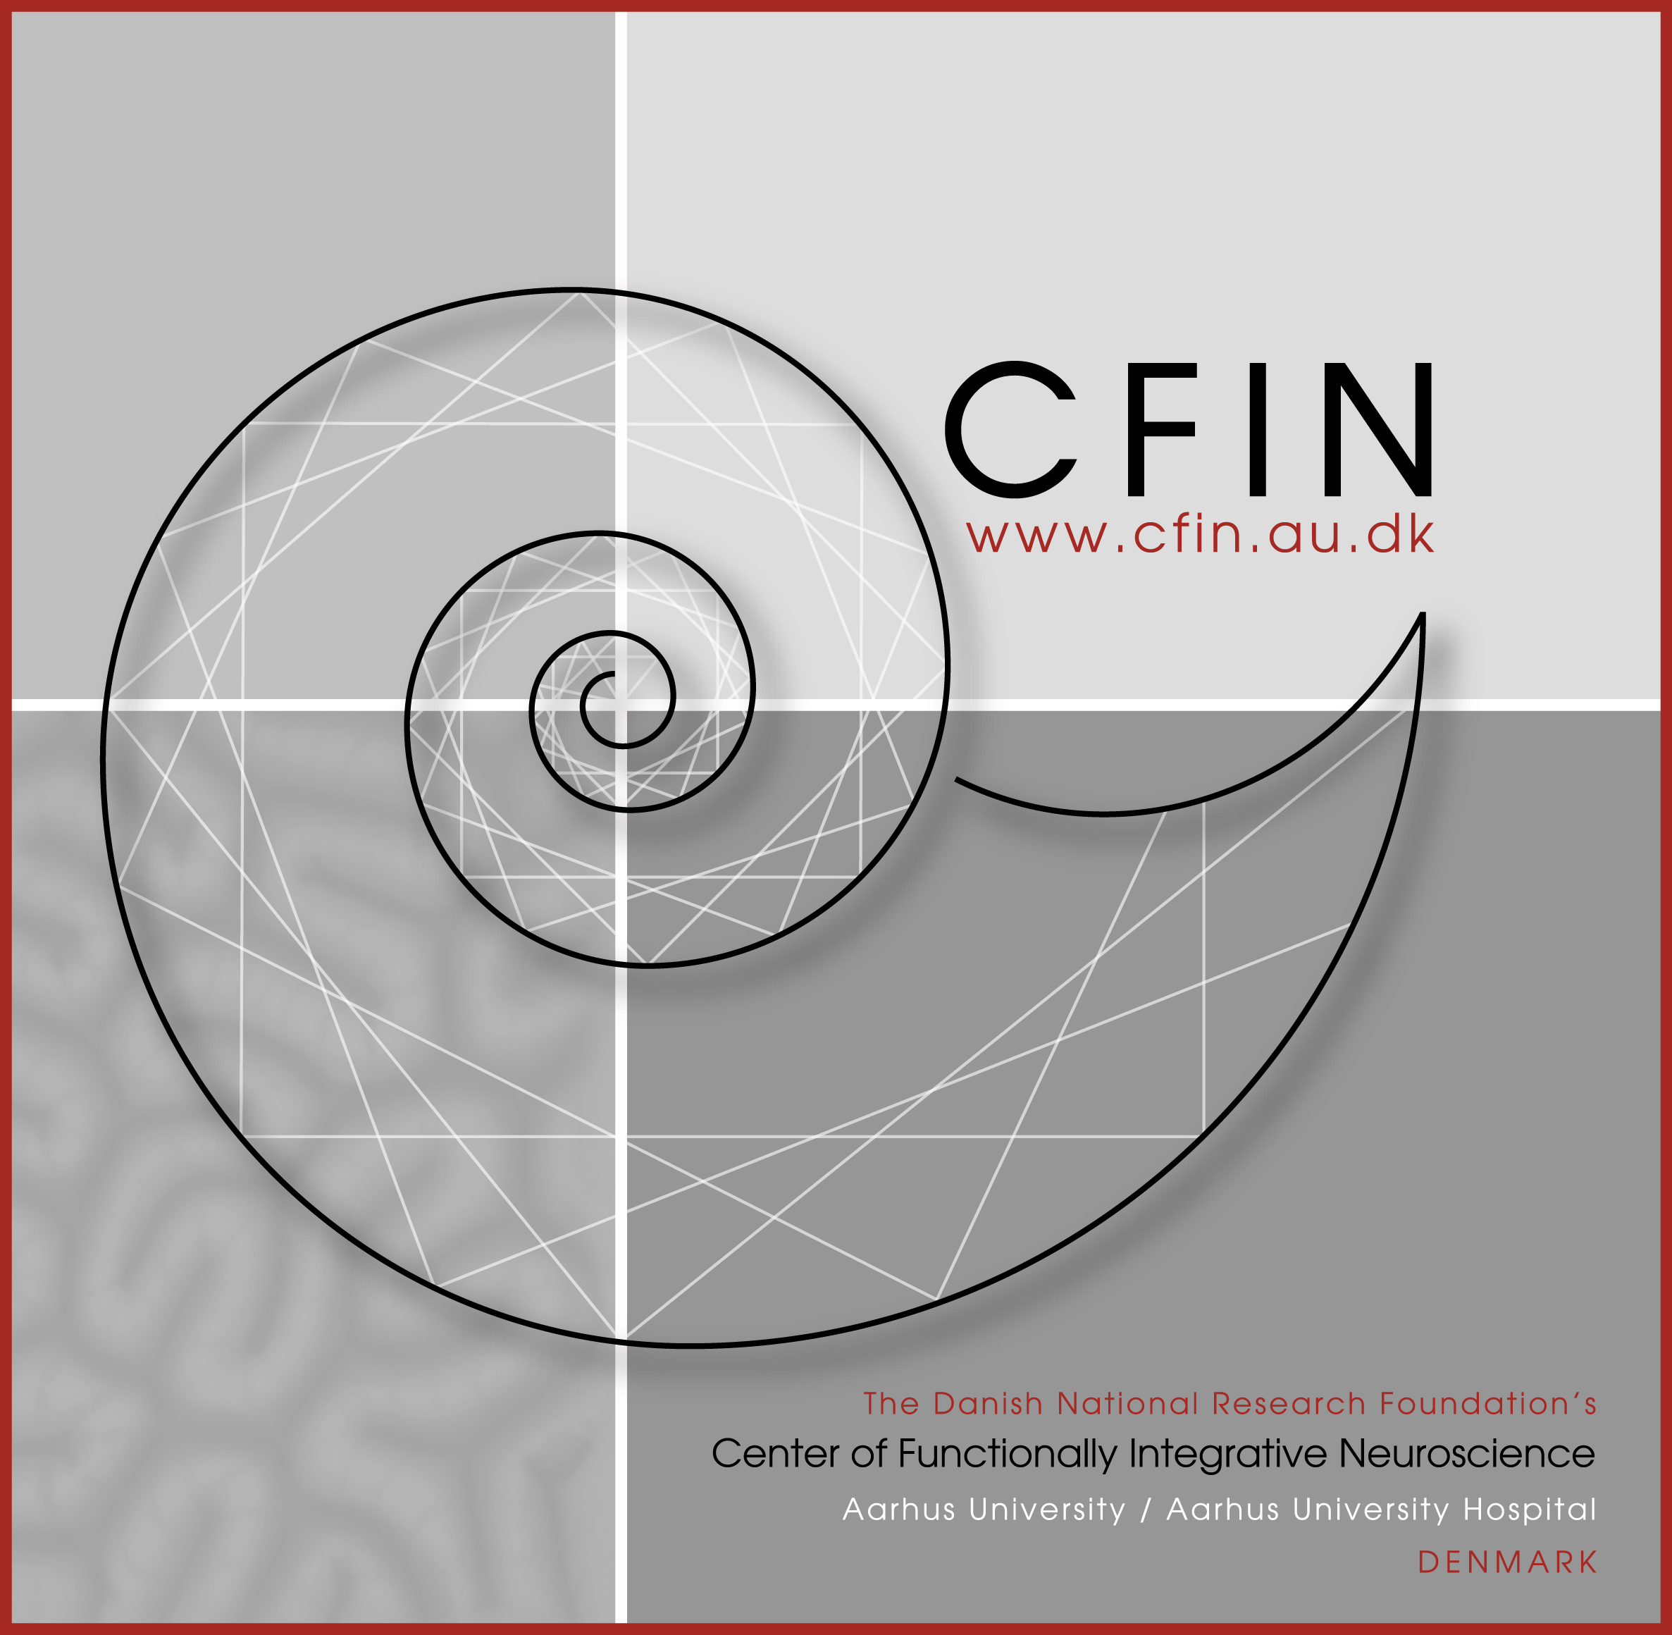



Introduction to Cognitive Science
8. Problem solving
Center of Functionally Integrative Neuroscience
Aarhus University/ Aarhus University Hospital - DENMARK
Mikkel Wallentin
mikkel.w@llentin.dk
Cognitive Science BSc
Cognitive Science
Aarhus University - DENMARK

Slide 2
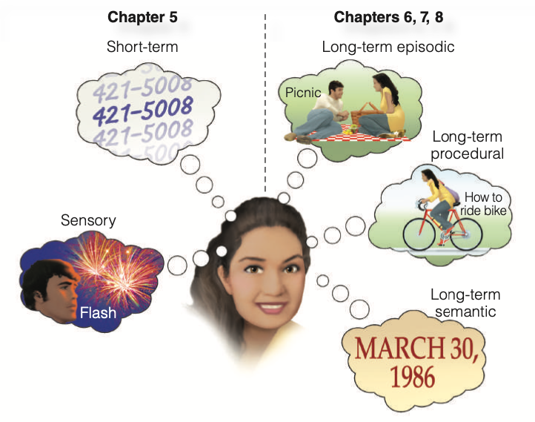


Memory catch-up
(Goldstein & van Hoof 2021, p. 126)
Center of Functionally Integrative Neuroscience
Aarhus University/ Aarhus University Hospital
Cognitive Science
Aarhus University

Slide 3
Memory is everywhere
Memory is involved in all cognitive processes.
As soon as a signal is translated into a cognitive/neural code it becomes a representation
from Latin re- an inseparable prefix meaning "again; back; anew, against.
i.e. a copy or index of the real thing
(Goldstein & van Hoof 2021, p. 126)
Center of Functionally Integrative Neuroscience
Aarhus University/ Aarhus University Hospital
Cognitive Science
Aarhus University

Slide 4
Multiple memory systems
The cognitive system contains multiple memory systems, defined by their
temporal duration (from short to long)
quality (episodic, procedural, semantic
(Goldstein & van Hoof 2021, p. 126)
Center of Functionally Integrative Neuroscience
Aarhus University/ Aarhus University Hospital
Cognitive Science
Aarhus University

Slide 5
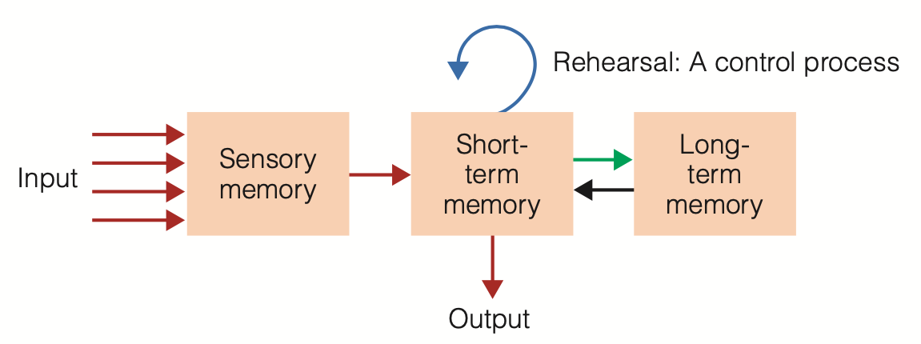
The modal model of memory
Signals pass through sensory memory, are processed in short-term memory and stored in long-term memory
(Atkinson & Shiffrin 1969; Goldstein & van Hoof 2021, p. 127)
Center of Functionally Integrative Neuroscience
Aarhus University/ Aarhus University Hospital
Cognitive Science
Aarhus University

Slide 6
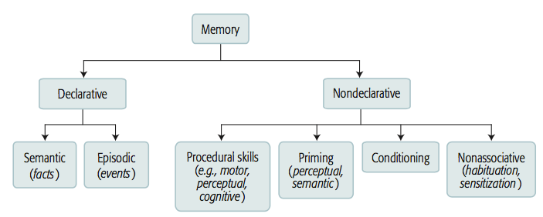
The long-term memory model
Memory
Declarative
Nondeclarative
Semantic
(Facts)
Episodic
(Events)
Procedural skills (e.g., motor, percptual, cognitive)
Priming (perceptual, semantic)
Conditioning
Nonassociative (habituation, sensitization)
(Figure similar to the one in Goldstein & van Hoof 2021, p. 165)
Center of Functionally Integrative Neuroscience
Aarhus University/ Aarhus University Hospital
Cognitive Science
Aarhus University

Slide 7
The long-term memory model
Memory without
conscious access
Memory you can talk about
Conscious access
Long-term Memory
Declarative
Nondeclarative
Semantic
(Facts)
Episodic
(Events)
Procedural skills (e.g., motor, percptual, cognitive)
Priming (perceptual, semantic)
Conditioning
Nonassociative (habituation, sensitization)
Abstract
Context free
Concrete
Context bound
(Goldstein & van Hoof 2021, p. 165)
Center of Functionally Integrative Neuroscience
Aarhus University/ Aarhus University Hospital
Cognitive Science
Aarhus University

Slide 8
Let’s work on this model…
Memory without
conscious access
Memory you can talk about
Conscious access
Long-term Memory
Declarative
Nondeclarative
Procedural skills (e.g., motor, percptual, cognitive)
Priming (perceptual, semantic)
Conditioning
Nonassociative (habituation, sensitization)
Abstract
Context free
Concrete
Context bound
(Goldstein & van Hoof 2021, p. 165)
Center of Functionally Integrative Neuroscience
Aarhus University/ Aarhus University Hospital
Cognitive Science
Aarhus University

Slide 9
Repetition increases abstraction and efficiency
… but sometimes decreases conscious access
Long-term Memory
Declarative
Nondeclarative
Episodic
(events)
Semantic
(facts)
Procedural skills (e.g., motor, percptual, cognitive)
Priming (perceptual, semantic)
Conditioning
Nonassociative (habituation, sensitization)
Scripts decontextualizes events
Concrete
Context bound
Abstract
Context free
(Goldstein & van Hoof 2021, p. 165)
Center of Functionally Integrative Neuroscience
Aarhus University/ Aarhus University Hospital
Cognitive Science
Aarhus University

Slide 10
It all starts with experience…
EVENT
Sensory stores
hearing, vision, etc
Forgetting
Attention
Short-term Memory
Long-term Memory
rehearsal
Recall
Declarative
Nondeclarative
Episodic
(events)
Semantic
(facts)
Procedural skills (e.g., motor, percptual, cognitive)
Priming (perceptual, semantic)
Conditioning
Nonassociative (habituation, sensitization)
Scripts decontextualizes events
Concrete
Context bound
Abstract
Context free
(Goldstein & van Hoof 2021, p. 165)
Center of Functionally Integrative Neuroscience
Aarhus University/ Aarhus University Hospital
Cognitive Science
Aarhus University

Slide 11
More on memory in coming weeks…
Center of Functionally Integrative Neuroscience
Aarhus University/ Aarhus University Hospital
Cognitive Science
Aarhus University

Slide 12
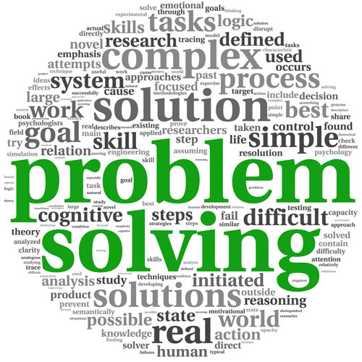
Problem solving
Center of Functionally Integrative Neuroscience
Aarhus University/ Aarhus University Hospital
Cognitive Science
Aarhus University

Slide 13
Problem solving: Reading questions
What is a problem?
The gestalt psychologists talk about restructuring, insight and fixation. What do they mean and what are the examples?
The information-processing approach describes problem solving in terms of a problem space with states and operators. What are those?
What is a means-end analysis?
What is an analogy and how may it facilitate problem solving
Expertise changes problem solving. Can your rephrase the notion of expertise using memory concepts?
Creativity is often good for problem solving. But how is creativity defined? Can it be linked to expertise and memory in both a positive and negative sense?
Grossnickle et al. 2016: Don’t spend to long on this paper. Consider first the examples in appendix A. Then look at table 2 and see how many of these measures are correlated, especially with visuospatial working memory (VS-WMC).
Center of Functionally Integrative Neuroscience
Aarhus University/ Aarhus University Hospital
Cognitive Science
Aarhus University

Slide 14
Questions from students
- How much research is being done in this field?
- What else has an effect on creativity? - how does negative moods effect creativity?
Center of Functionally Integrative Neuroscience
Aarhus University/ Aarhus University Hospital
Center for Semiotics
Aarhus University

Slide 15
What is a problem?
A problem occurs when there is an obstacle between a present state and a goal
(Goldstein & van Hoof 2021, p. 369)
Center of Functionally Integrative Neuroscience
Aarhus University/ Aarhus University Hospital
Cognitive Science
Aarhus University

Slide 16
Descriptive and prescriptive approaches
Descriptive
Investigate how cognitive systems solve problems
Prescriptive
Investigate how cognitive systems can optimise problem solving
Cognitive science covers a middle ground due to its ties with both psychology (primarily descriptive) and computer science (primarily prescriptive)
Center of Functionally Integrative Neuroscience
Aarhus University/ Aarhus University Hospital
Cognitive Science
Aarhus University

Slide 17
Characteristics of cognitive problem solving
Goal directedness
Setting of subgoals
Operator application
Problem Space: Set of states the problem can be in
States
Start state
Intermediate states
Goal state
(Goldstein & van Hoof 2021, p. 378-)
Center of Functionally Integrative Neuroscience
Aarhus University/ Aarhus University Hospital
Cognitive Science
Aarhus University

Slide 18

Well- and Ill-defined problems
Problems can be classified into two different types (ill-defined and well-defined) from which appropriate solutions are to be made.
Well-defined problems have specific goals, clearly defined solution paths, and clear expected solutions.
Ill-defined problems are those that do not have clear goals, solution paths, or expected solution.
Center of Functionally Integrative Neuroscience
Aarhus University/ Aarhus University Hospital
Cognitive Science
Aarhus University

Slide 19
Problem solving IRL
Human problems are most often ill-defined.
Center of Functionally Integrative Neuroscience
Aarhus University/ Aarhus University Hospital
Cognitive Science
Aarhus University

Slide 20
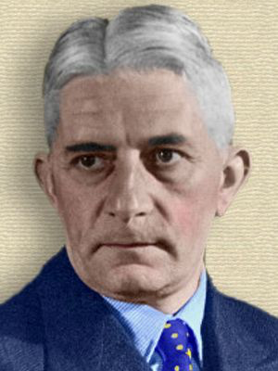
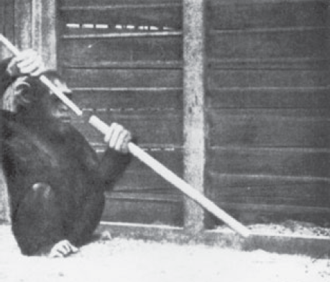
The Gestalt approach
Wolfgang Köhler (1927) would place a banana on a ceiling hook and observe how the chimps would use available material to try to reach it.
After some time the chimp would, with a great suddenness, solve the problem by stacking crates on top of each other.
Köhler termed this behaviour insight learning
Sultan, a chimpanzee, also learned to put two sticks together to make it longer
Wolfgang Köhler (1887-1967)
(Köhler, 1925, The Mentality of Apes, Goldstein & van Hoof 2021, p. 370-371)
Center of Functionally Integrative Neuroscience
Aarhus University/ Aarhus University Hospital
Cognitive Science
Aarhus University

Slide 21
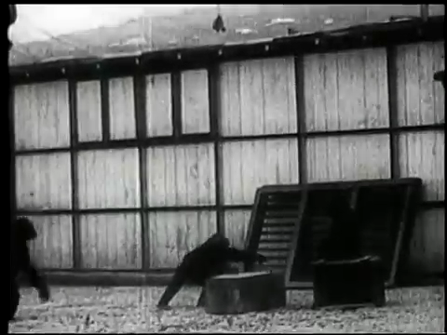
Video from Köhlers work
Center of Functionally Integrative Neuroscience
Aarhus University/ Aarhus University Hospital
Cognitive Science
Aarhus University

Slide 22
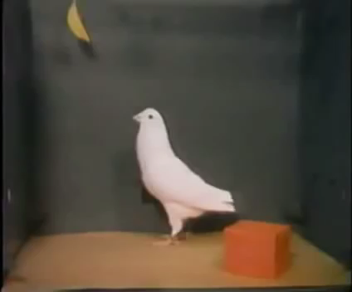
Now watch this!
Center of Functionally Integrative Neuroscience
Aarhus University/ Aarhus University Hospital
Cognitive Science
Aarhus University

Slide 23
What’s the story?
If pigeons are capable of “insight learning” it must be less “magical” and “human-like” than suggested when seeing monkeys solve the problem.
Center of Functionally Integrative Neuroscience
Aarhus University/ Aarhus University Hospital
Cognitive Science
Aarhus University

Slide 24
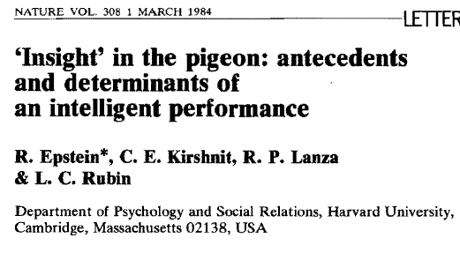
Background for the pigeon experiment
“Research and theory suggest that chimpanzees will not solve problems of this sort if they have not first had certain experiences. We speculated that two behaviours had to have been acquired: pushing objects towards targets and climbing on objects to reach other objects.”
Epstein, R., Kirshnit, C. E., Lanza, R. P., & Rubin, L. C. (1984). “Insight” in the pigeon: antecedents and determinants of an intelligent performance. Nature, 308(5954), 61–62.
Center of Functionally Integrative Neuroscience
Aarhus University/ Aarhus University Hospital
Cognitive Science
Aarhus University

Slide 25
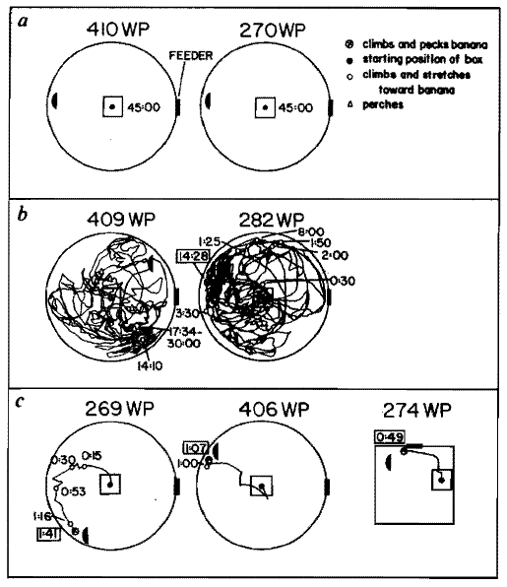
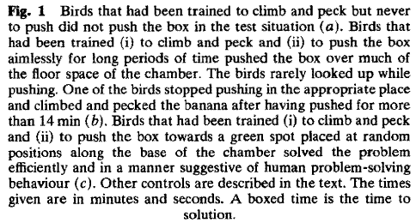
Epstein, R., Kirshnit, C. E., Lanza, R. P., & Rubin, L. C. (1984). “Insight” in the pigeon: antecedents and determinants of an intelligent performance. Nature, 308(5954), 61–62.
Center of Functionally Integrative Neuroscience
Aarhus University/ Aarhus University Hospital
Cognitive Science
Aarhus University

Slide 26
Take-home messages
Insight learning may be broken down into smaller units.
What appears to be a very complex solution, may be a combination of simpler learned skills.
Creativity may be (partly) defined as putting together known skills in a novel fashion.
Functional fixedness is the inability to apply known skills in novel contexts
e.g. Dunckers candle problem
(Goldstein & van Hoof 2021, p. 374-)
Center of Functionally Integrative Neuroscience
Aarhus University/ Aarhus University Hospital
Cognitive Science
Aarhus University

Slide 27
Behaviorist approaches to problem solving
Center of Functionally Integrative Neuroscience
Aarhus University/ Aarhus University Hospital
Cognitive Science
Aarhus University

Slide 28
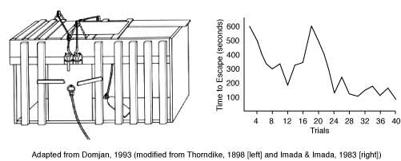
Trial-and-error Learning (discovery)
The early behaviorist E.L. Thorndike (1898) studied hungry cats trying to get out of a cage to reach food.
The cage door could be opened only if a pole inside was hit.
Initially cats managed this only by chance, but upon repeated trials they gradually acquired the skills.
But was this goal-directed?
Center of Functionally Integrative Neuroscience
Aarhus University/ Aarhus University Hospital
Cognitive Science
Aarhus University

Slide 29

Seeing is believing: staged documentary
https://www.youtube.com/watch?v=BDujDOLre-8
Center of Functionally Integrative Neuroscience
Aarhus University/ Aarhus University Hospital
Cognitive Science
Aarhus University

Slide 30

Fun example with dog
https://www.youtube.com/watch?v=y-g2OmRXb0g
Center of Functionally Integrative Neuroscience
Aarhus University/ Aarhus University Hospital
Cognitive Science
Aarhus University

Slide 31
The information-processing approach
Information processing approach = cognitive/computational approach
Center of Functionally Integrative Neuroscience
Aarhus University/ Aarhus University Hospital
Cognitive Science
Aarhus University

Slide 32
The Nature of Problem Solving: Search
The challenge is to find some sequence of operators in the problem space that leads from the start state to the goal state.
SEARCH
The problem solver must find the path through a maze of states.
May involve constructing search trees (set of states that can be reached by applying operator to a start state)
(Goldstein & van Hoof 2021, p. 378-)
Center of Functionally Integrative Neuroscience
Aarhus University/ Aarhus University Hospital
Cognitive Science
Aarhus University

Slide 33
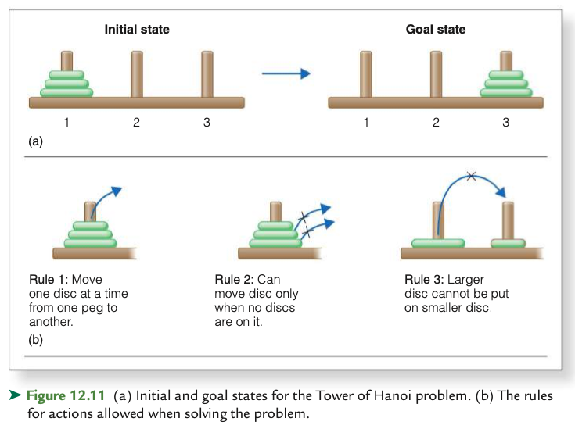
Tower of Hanoi example
(Goldstein & van Hoof 2021, p. 380-)
Center of Functionally Integrative Neuroscience
Aarhus University/ Aarhus University Hospital
Cognitive Science
Aarhus University

Slide 34
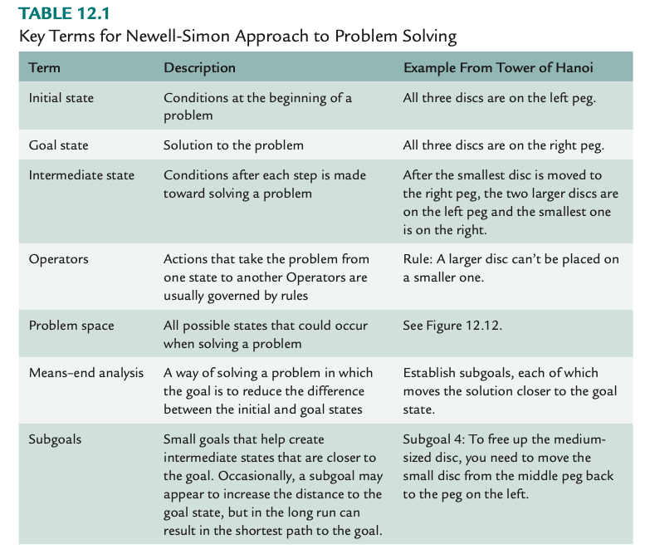
(Goldstein & van Hoof 2021, p. 380-)
Center of Functionally Integrative Neuroscience
Aarhus University/ Aarhus University Hospital
Cognitive Science
Aarhus University

Slide 35
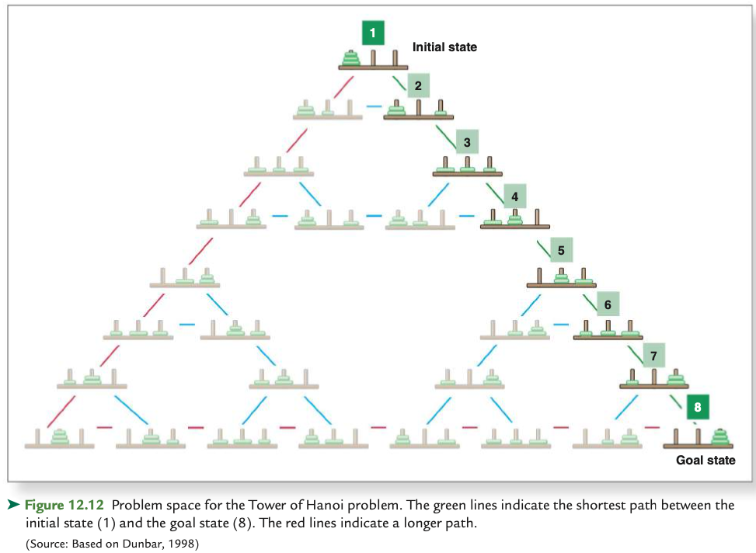
(Goldstein & van Hoof 2021, p. 380-)
Center of Functionally Integrative Neuroscience
Aarhus University/ Aarhus University Hospital
Cognitive Science
Aarhus University

Slide 36
Sequence of operations: Algorithm
An algorithm is an effective method that can be expressed within a finite amount of space and time and in a well-defined formal language for calculating a function. Starting from an initial state and initial input (perhaps empty), the instructions describe a computation that, when executed, proceeds through a finite number of well-defined successive states, eventually producing "output"
https://en.wikipedia.org/wiki/Algorithm
Center of Functionally Integrative Neuroscience
Aarhus University/ Aarhus University Hospital
Cognitive Science
Aarhus University

Slide 37
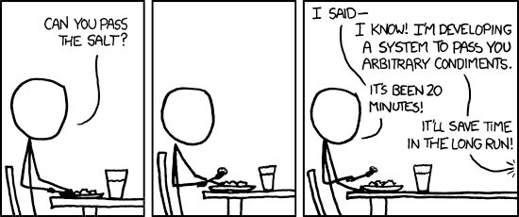
From theory to practice
https://xkcd.com/974/
Center of Functionally Integrative Neuroscience
Aarhus University/ Aarhus University Hospital
Cognitive Science
Aarhus University

Slide 38
Take-home messages
Cognition as Information-processing forms a link between human problem solving and computation.
A generalised solution is an algorithm
Finding the shortest path from initial state to goal state is an optimisation process, i.e. prescriptive
(Goldstein & van Hoof 2021, p. 374-)
Center of Functionally Integrative Neuroscience
Aarhus University/ Aarhus University Hospital
Cognitive Science
Aarhus University

Slide 39
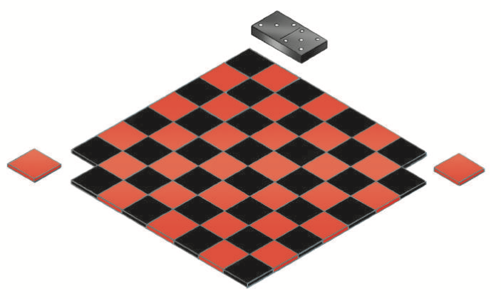
The Importance of correct representation
A piece needs to cover both a white and black square
Therefore there is no solutions
The mutilated Checkerboard problem (Kaplan and Simon, 1990)
Can 31 pieces cover the 62 square board?
Difficult…
(Goldstein & van Hoof 2021, p. 383)
Center of Functionally Integrative Neuroscience
Aarhus University/ Aarhus University Hospital
Cognitive Science
Aarhus University
Notes:
Figure 8.13 source: (After Wickelgren, 1974. Adapted by permission of the publisher. © 1974 by W. H. Freeman.)

Slide 40
Finding Operators: ANALOGY
Process by which a problem solver maps the solution for one problem onto a solution for another problem
Can be used if two problems have different surface, but similar deep structure
E.g. Gick and Holyoak (1980)
Tumor problem
Fortress problem
(Goldstein & van Hoof 2021, p. 387-388)
Center of Functionally Integrative Neuroscience
Aarhus University/ Aarhus University Hospital
Cognitive Science
Aarhus University

Slide 41
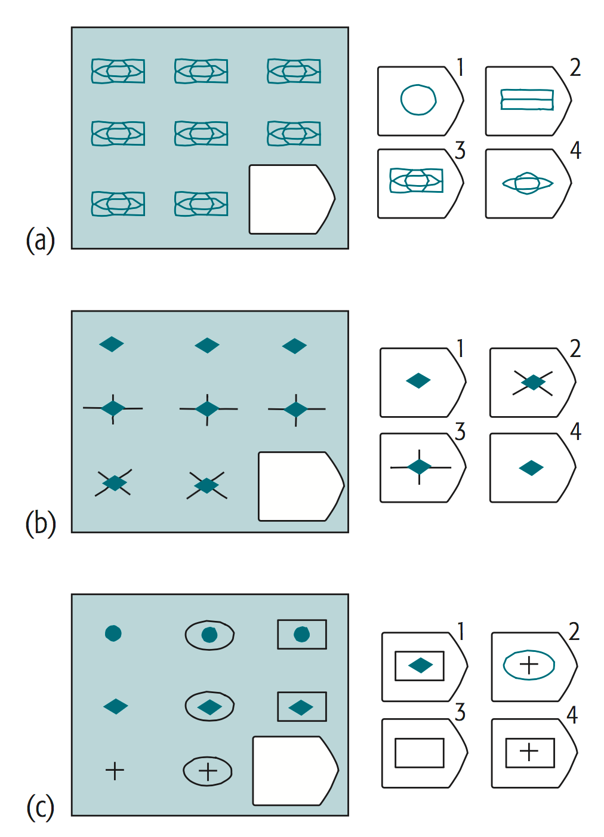
Difficulties in applying analogies
Analogy involves noticing that a past problem solution is relevant
Participants had to be made aware that the fortress story was relevant for tumor problem
Then mapping the elements from that solution to produce an operator for the current problem
Analogical reasoning is used in IQ tests like Raven’s progressive matrices
Anderson p. 190-191
Center of Functionally Integrative Neuroscience
Aarhus University/ Aarhus University Hospital
Cognitive Science
Aarhus University

Slide 42
What is expertise?
The use of memory in problem solving!
Center of Functionally Integrative Neuroscience
Aarhus University/ Aarhus University Hospital
Cognitive Science
Aarhus University

Slide 43
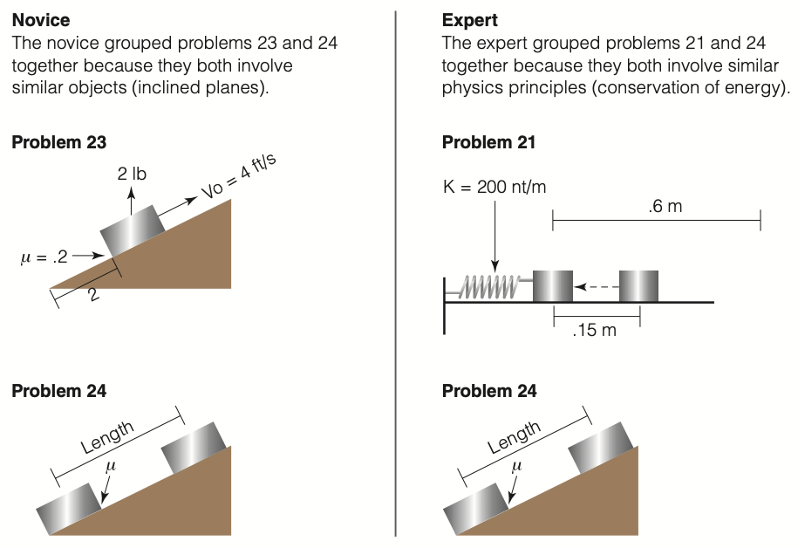
Problem perception
An important dimension of growing expertise is the development of a set of richer perceptual features for encoding problems.
Chi, Feltovich, and Glaser (1981) studied categorisation of physics problems:
Experts shifted their classification from reliance on simple features to reliance on more complex (deeper) features.
(Goldstein & van Hoof 2021, p. 394)
Center of Functionally Integrative Neuroscience
Aarhus University/ Aarhus University Hospital
Cognitive Science
Aarhus University

Slide 44
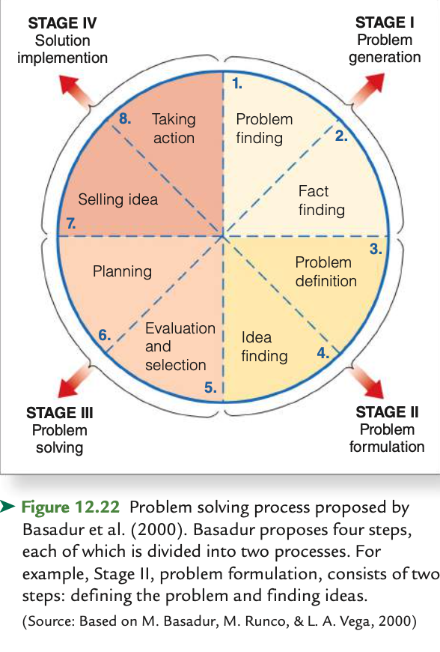
Problem solving as a process
(Goldstein & van Hoof 2021, p. 398)
Center of Functionally Integrative Neuroscience
Aarhus University/ Aarhus University Hospital
Cognitive Science
Aarhus University

Slide 45
Individual differences in problem solving
Problem solving influenced by
Context (walking, cues, mood)
Expertise (Memory)
Openness to experience (personality trait)
General cognitive abilities (IQ)
(Goldstein & van Hoof 2021, p. 398-)
Center of Functionally Integrative Neuroscience
Aarhus University/ Aarhus University Hospital
Cognitive Science
Aarhus University

Slide 46
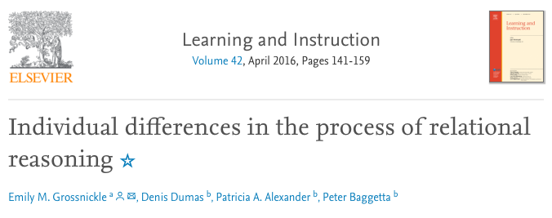
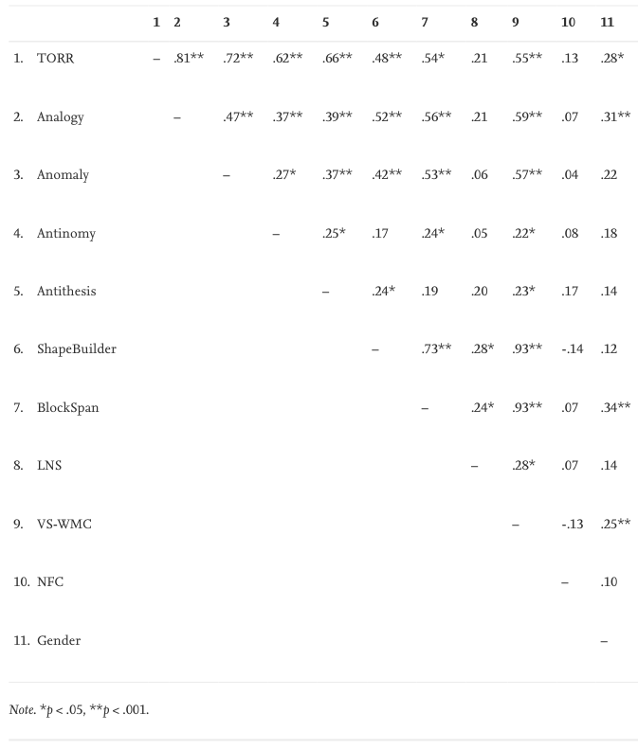
Many tasks correlate with visuospatial working memory: General cognitive ability
Center of Functionally Integrative Neuroscience
Aarhus University/ Aarhus University Hospital
Cognitive Science
Aarhus University

Slide 47
Problem solving: Summary
What is a problem?
The gestalt psychologists talk about restructuring, insight and fixation. What do they mean and what are the examples?
The information-processing approach describes problem solving in terms of a problem space with states and operators. What are those?
What is a means-end analysis?
What is an analogy and how may it facilitate problem solving
Expertise changes problem solving. Can your rephrase the notion of expertise using memory concepts?
Creativity is often good for problem solving. But how is creativity defined? Can it be linked to expertise and memory in both a positive and negative sense?
Grossnickle et al. 2016: Don’t spend to long on this paper. Consider first the examples in appendix A. Then look at table 2 and see how many of these measures are correlated, especially with visuospatial working memory (VS-WMC).
A problem is when there is an obstacle between the present state and the goal state
Restructuring and fixation are linked to finding solutions by framing them differently or dividing them up into smaller parts or failing to do so, due to prior knowledge
insight is the sudden realisation of the solution
problem space with states and operators yield an algorithmic approach to problem solving?
In means-end analysis we find subgoals to get us closer to solving the problem (find bucket to get water).
Structures from one problem domain may be applied to other domains. This is analogy
Expertise is stored in long-term knowledge, both procedural, semantic and episodic. This changes the way we perceive and process problems (which involves working-memory)
Creativity is the ability to linke hitherto non-linked domains of knowledge. Since expertise increases knowledge, it facilitates creativity, but may also evoke fixation.
Grossnickle et al. 2016: Data shows that ability in different kinds of problem solving are correlated. May be due to general cognitive ability, a.k.a. intelligence.
Center of Functionally Integrative Neuroscience
Aarhus University/ Aarhus University Hospital
Cognitive Science
Aarhus University

Slide 48
Additional slides…
Center of Functionally Integrative Neuroscience
Aarhus University/ Aarhus University Hospital
Cognitive Science
Aarhus University

Slide 49
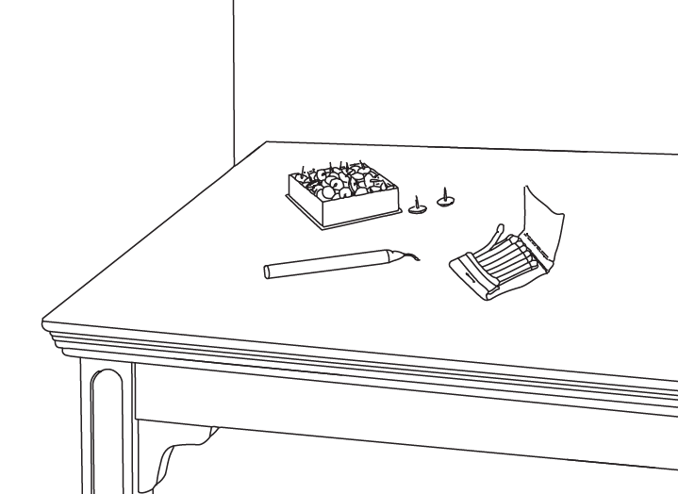
Functional Fixedness
The tendency to represent objects as serving conventional problem-solving functions and thus failing to see that they can serve novel functions
The candle problem used by Duncker (1945) in a study of functional fixedness
(Goldstein & van Hoof 2021, p. 375)
Center of Functionally Integrative Neuroscience
Aarhus University/ Aarhus University Hospital
Cognitive Science
Aarhus University

Slide 50
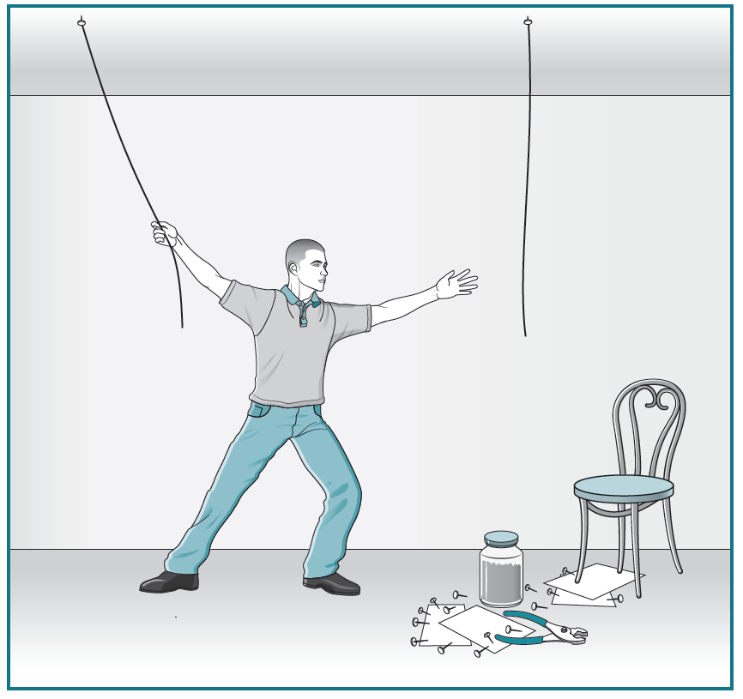
Problem Representation: Functional Fixedness
The two-string problem used by Maier to demonstrate functional fixedness
Only 39% of Maier’s participants were able to see the solution within 10 minutes.
A large majority of the participants did not perceive the pliers as a weight that could be used as a pendulum.
(Goldstein & van Hoof 2021, p. 376)
Center of Functionally Integrative Neuroscience
Aarhus University/ Aarhus University Hospital
Cognitive Science
Aarhus University
Notes:
Figure 8.14 source: (After Maier, 1931. Adapted by permission of the publisher. © 1931 by the Journal of Comparative Psychology.)

Slide 51
Set (or Einstellung) Effects
The biasing of a solution to a problem as a result of past experiences in solving that kind of problem
People often repeat a solution that has worked for previous problems, even when a simpler solution is possible
Luchins 1942, Luchins & Luchins 1959, Anderson p. 203
Center of Functionally Integrative Neuroscience
Aarhus University/ Aarhus University Hospital
Cognitive Science
Aarhus University

Slide 52
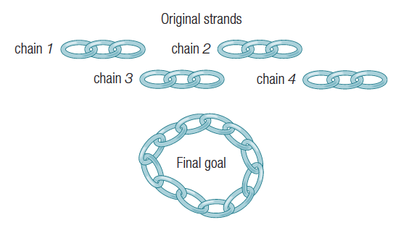
Incubation effects
Phenomenon that sometimes solutions to a particular problem come easier after a period of time in which one has ignored trying to solve the problem
Not magical: Occur when inappropriate strategies are forgotten
The Cheap necklace problem (Silveira,1971)
has a very appealing, but wrong solution
Anderson p. 204
Center of Functionally Integrative Neuroscience
Aarhus University/ Aarhus University Hospital
Cognitive Science
Aarhus University

Slide 53
Eureka moments: Insight
Metcalfe and Wiebe (1987): Suggested insight problem is one in which people are not aware they are close to a problem
e.g. cheap-necklace problem
Kaplan and Simon (1990): Problems whose solution depend on one key insight; “aha” experience
e.g. mutilated-checkerboard problem
e.g. NOT Tower of Hanoi
Eureka: Archimedes in the bath
Anderson p. 204
Center of Functionally Integrative Neuroscience
Aarhus University/ Aarhus University Hospital
Cognitive Science
Aarhus University

Slide 54
More Algorithm definition
An algorithm is an unambiguous description that makes clear what has to be implemented, e.g. “Bake until done” is ambiguous because it doesn’t explain what “done” means. “Bake until the cheese begins to bubble” is better.
An algorithm expects a defined set of inputs. For example, it might require two numbers where both numbers are greater than zero. Or it might require a word, or a list of zero or more numbers.
An algorithm produces a defined set of outputs. It might output the larger of the two numbers, an all-uppercase version of a word, or a sorted version of the list of numbers.
An algorithm is guaranteed to terminate and produce a result, always stopping after a finite time. If an algorithm could potentially run forever, it wouldn’t be very useful because you might never get an answer.
Most algorithms are guaranteed to produce the correct result. It’s rarely useful if an algorithm returns the largest number 99% of the time, but 1% of the time the algorithm fails and returns the smallest number instead.
If an algorithm imposes a requirement on its inputs (called a precondition), that requirement must be met. For example, a precondition might be that an algorithm will only accept positive numbers as an input. If preconditions aren’t met, then the algorithm is allowed to fail by producing the wrong answer or never terminating.
https://fiftyexamples.readthedocs.org/en/latest/algorithms.html
Center of Functionally Integrative Neuroscience
Aarhus University/ Aarhus University Hospital
Cognitive Science
Aarhus University

Slide 55
Example algorithm: Find largest number of a list
Algorithm:
Set max to 0.
For each number x in the list L, compare it to max. If x is larger, set max to x.
max is now set to the largest number in the list.
An implementation in Python:
def find_max (L):
max = 0
for x in L:
if x > max:
max = x
return max
Center of Functionally Integrative Neuroscience
Aarhus University/ Aarhus University Hospital
Cognitive Science
Aarhus University

Slide 56
Tactical and strategic expertise
Center of Functionally Integrative Neuroscience
Aarhus University/ Aarhus University Hospital
Cognitive Science
Aarhus University

Slide 57
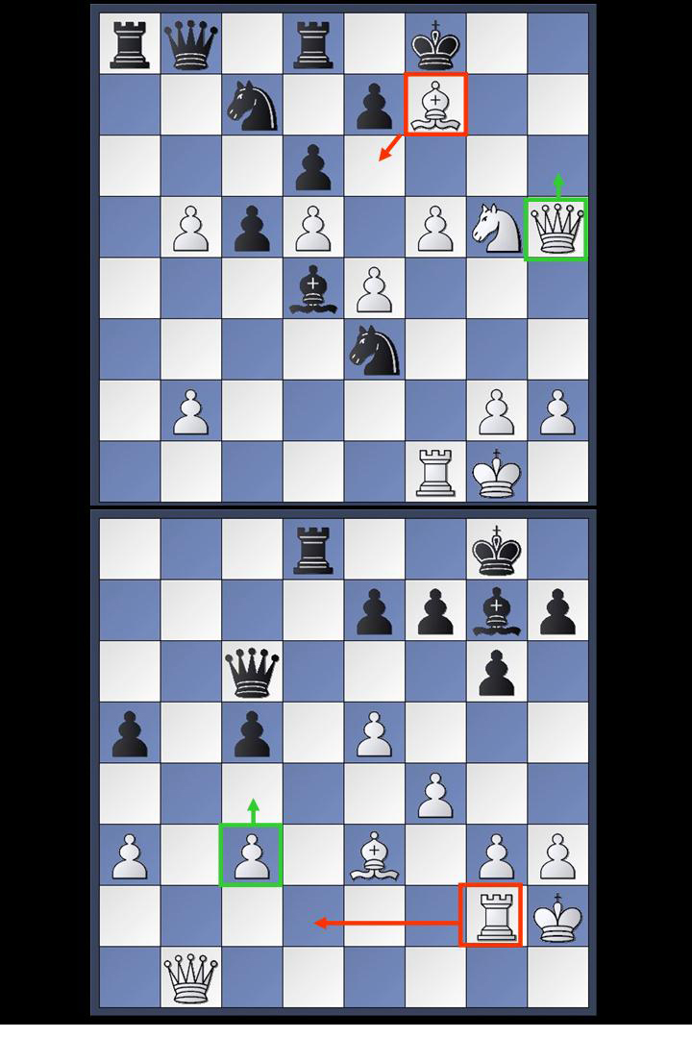
Chess: Tactical vs. Strategic Positions
Ex. 1: Tactical Position
Ex. 2: Strategic Position
Center of Functionally Integrative Neuroscience
Aarhus University/ Aarhus University Hospital
Cognitive Science
Aarhus University

Slide 58
Tactical expertise
TACTICAL LEARNING
Learning of sequences of actions that help solve a problem
TACTIC
Refers to a method that accomplishes a particular goal
Ex. 1: Tactical Position
Anderson p. 217-218
Center of Functionally Integrative Neuroscience
Aarhus University/ Aarhus University Hospital
Cognitive Science
Aarhus University

Slide 59
Strategic expertise
STRATEGIC LEARNING
Learning how to organize one’s problem-solving for a specific class of problems
Tactical learning involves learning new pieces of skill, whereas strategic learning is concerned with putting them together.
Anderson p. 218-219
Ex. 2: Strategic Position
Center of Functionally Integrative Neuroscience
Aarhus University/ Aarhus University Hospital
Cognitive Science
Aarhus University

Slide 60
Generalized Problem solving
Problem solving tries to find general strategies that cut across a large range of different problems,
e.g. “The general problem solver” GPS (Simon & Newel 1959)
Any problem that can be expressed as a set of well-formed formulas can be solved, in principle, by GPS.
While GPS solved simple problems such as the Towers of Hanoi that could be sufficiently formalized, it could not solve any real-world problems because search was easily lost in the combinatorial explosion.
Center of Functionally Integrative Neuroscience
Aarhus University/ Aarhus University Hospital
Cognitive Science
Aarhus University

Slide 61
Problem solving is learning
The task of acquiring new information can be viewed as an instance of problem solving.
Bransford et al. emphasize five components:
Identify the existence of a problem
Define the problem more precisely
Explore possible solutions
Act on the obtained possible solution
Look and Learn (evaluate the process)
Bransford, J., Sherwood, R., Vye, N., & Rieser, J. (1986). Teaching thinking and problem solving: Research foundations. American Psychologist.
Center of Functionally Integrative Neuroscience
Aarhus University/ Aarhus University Hospital
Cognitive Science
Aarhus University

